Slide 1



DRIVER DROWSINESS DETECTION AND ALERT SYSTEM
KAMALESH BADOLA 1NH20EE048
KUSHAL NAIK K 1NH20EE056
LAVA KUMAR M N 1NH20EE057
MOHAMMED AMAN 1NH21EE407
20EEL59B
Date of Presentation: 10.03.2023
Guided By
Dr. Vinoth Kumar K
Associate Professor
Department of Electrical & Electronics Engineering
Bengaluru 560103, Karnataka, India

Slide 2
Introduction
Driver drowsiness detection is a car safety technology which helps prevent accidents caused by the driver getting drowsy.
Various studies have suggested that around 20% of all road accidents are fatigue-related, up to 50% on certain roads.
Driver drowsiness system shall be designed in such a way that those systems do not continuously record nor retain any data other than what is necessary in relation to the purposes for which they were collected or otherwise processed within the closed-loop system

Slide 3
Objective
The aim of the project is to design and develop a Drowsiness detection and alert system .
2

Slide 4
Literature Survey
Table.1
Title of the paper | Author | Source & Year of Publication | Outcome of the paper
"Vision-based ACC with a Single Camera: Bounds on Range and Range Rate Accuracy” “Development of Real-Time Eye Tracking Algorithm” “Machine Learning Inspired Vision-based Drowsiness Detection using Eye and Body Motion Features” | G. P. Stein, O. Mano and A. Shashua, Siti Nuradlin Syahirah Sheikh Anwar, Azrina Abd Aziz, Syed Hasan Adil, Ali Ayub Sheikh, Junaid Mir, | IEEE IV ’03, pp. 120-125, 2003. 2021 4th International Conference on Computing & Information Sciences (ICCIS), pp.1-6, 2021. 2021 13th International Conference on Information & Communication Technology and System (ICTS), pp.146-150, 2021. | Detail introduction of detection of eye and sensors working illustrates the implementation of tracking of eye The paper includes detection of drowsiness and how the processing happens.
3

Slide 5
Problem Statement
The number of road accidents due to Drowsy Driving is increasing at an alarming rate worldwide. Not having a proper sleep is the main reason behind drowsiness while driving. However, other reasons like sleep disorders, medication, alcohol consumption, or driving during night shifts can also cause drowsiness while driving.
4

Slide 6

Block Diagram
9V DC Battery
Eye blink
Sensor - IR
7805 Voltage Regulator
Arduino UNO
16Mhz ATmega328
RF transmitter
RSI 433MHz
12V DC supply
RF receiver
RSI 433MHz
Buzzer

Slide 7
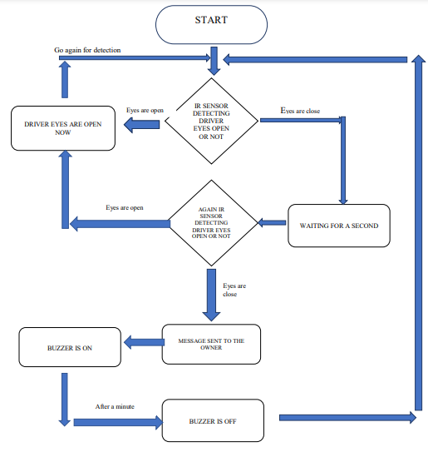
Flow Chart

Slide 8
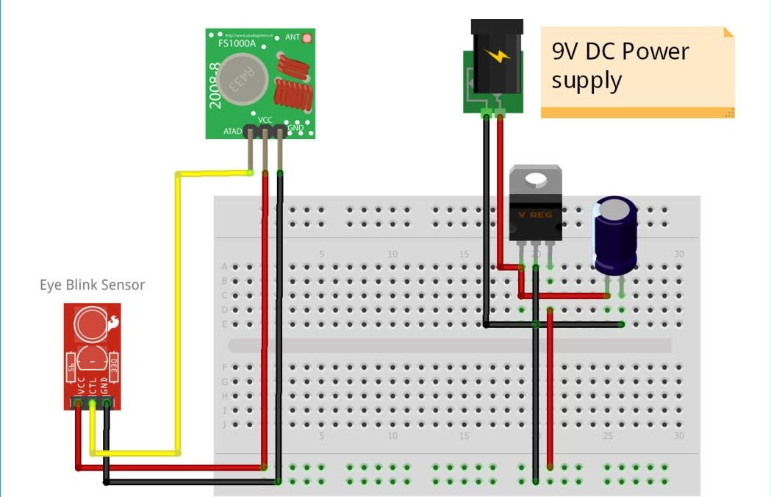
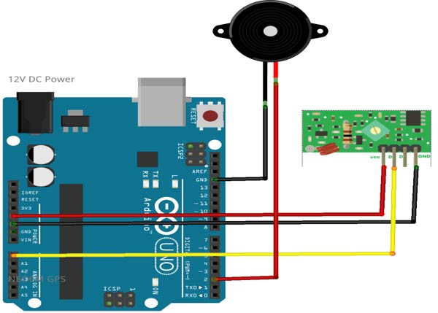
CIRCUIT DIAGRAM

Slide 9
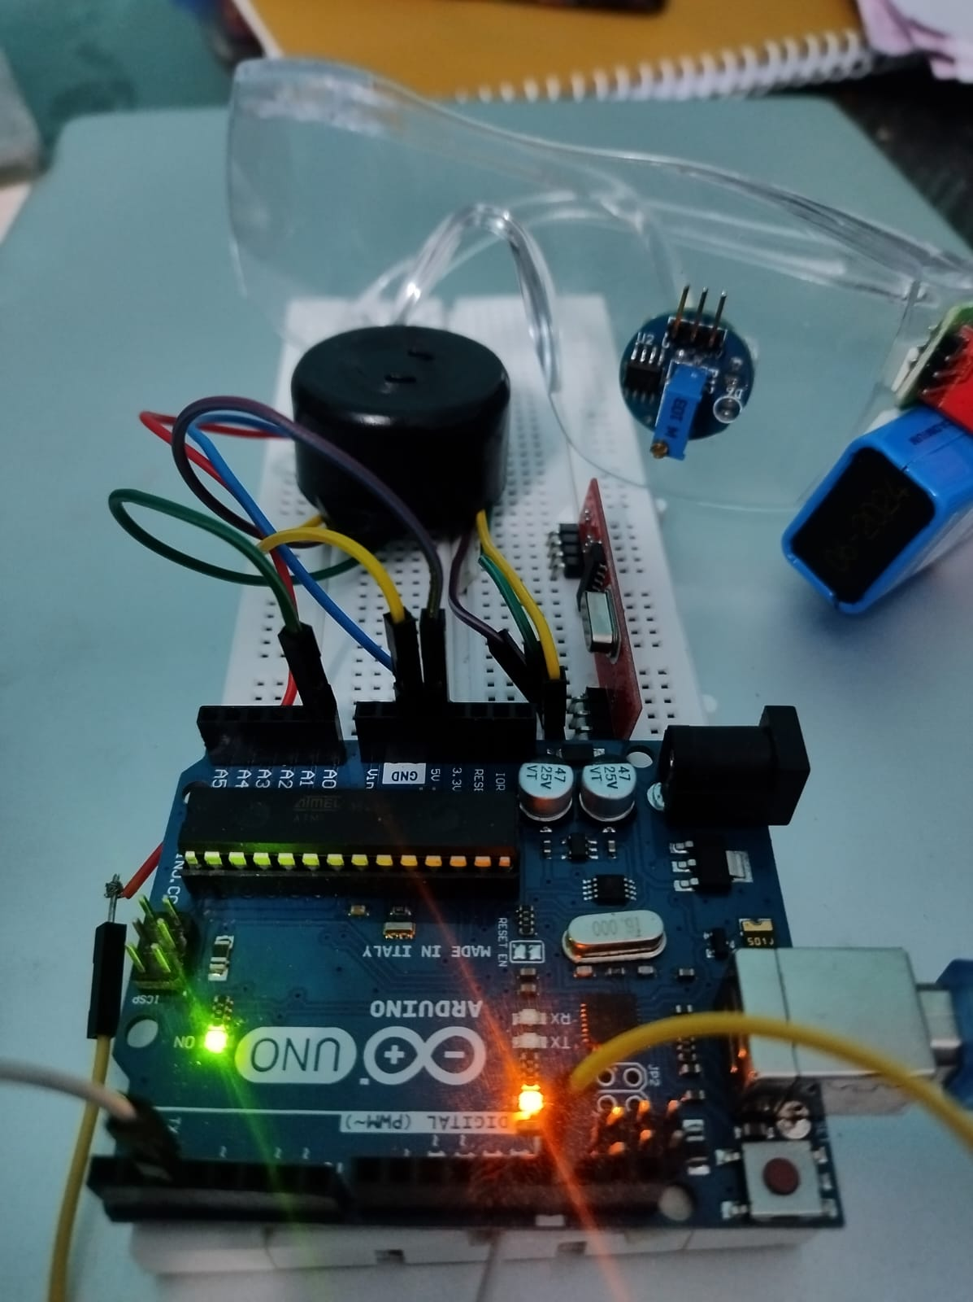
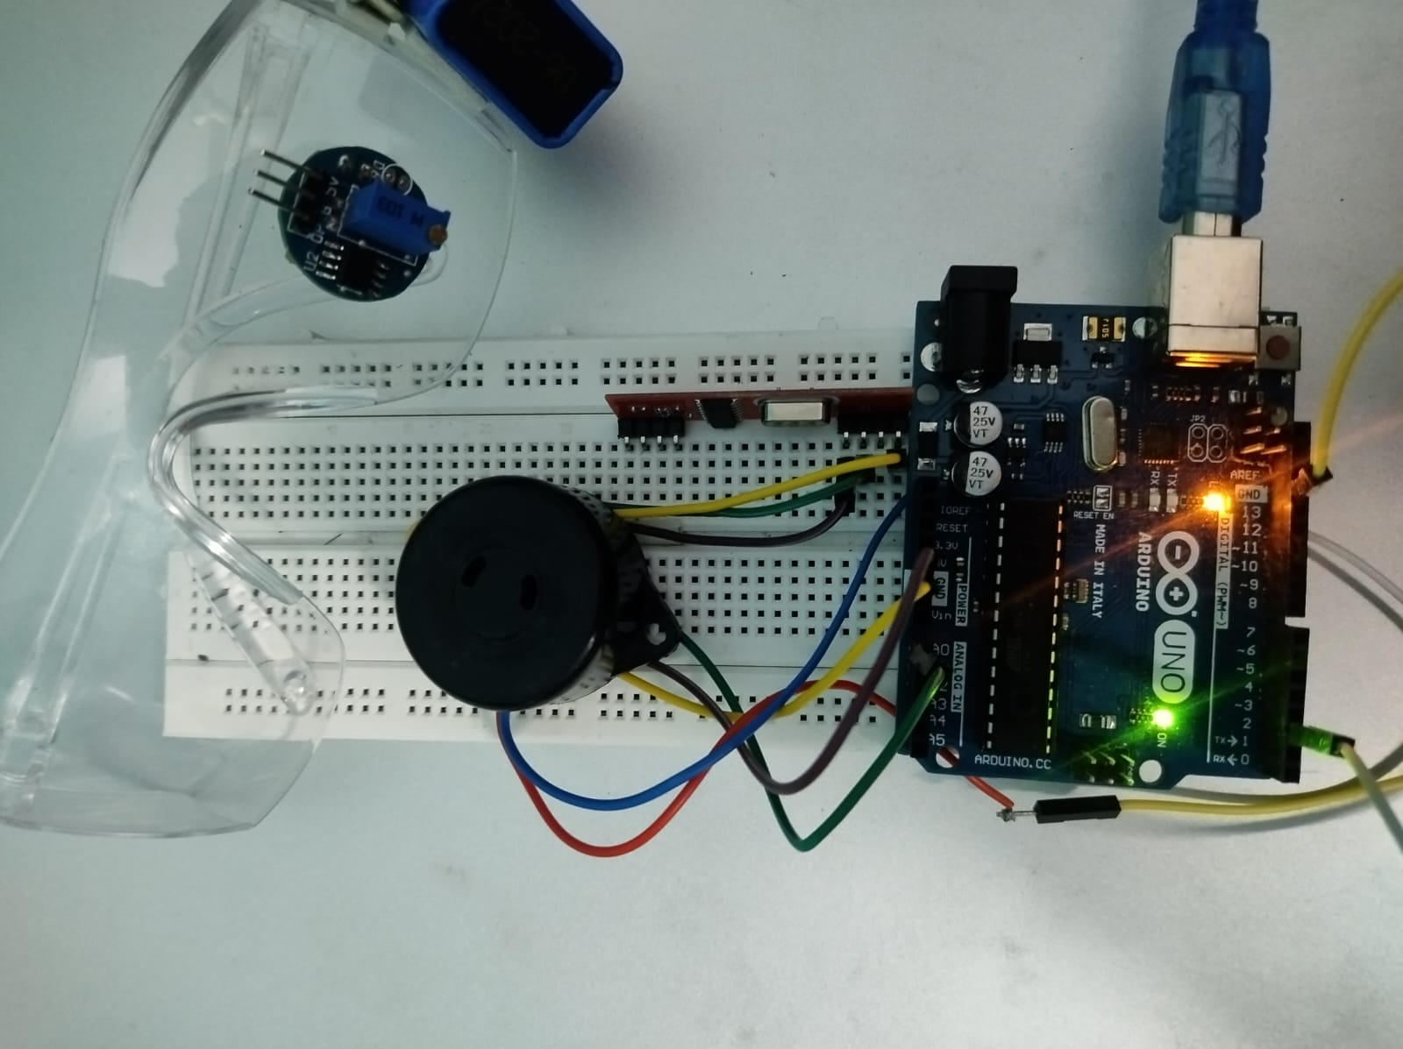
HARDWARE PICTURE

Slide 10
Components with specifications required
ARDUINO UNO - 16Mhz ATmega328
EYE BLINK SENSOR - IR SENSOR
RF TRANSCEIVER MODEL -RSI 433 MHz
VOLTAGE REGULATOR - 7805 IC
BATTERY- 9V
DC POWER SUPPLY - 12V
BUZZER
CONNECTING WIRES

Slide 11
Advantages
This system is an immediate aid system.
It is an affordable system.
This system can be used for a social cause.
It does not need any operation manually.
The detected abnormal behavior is corrected through alarms in real time.
Life of the driver can be saved by alerting him using the alarm system.
Traffic management can be maintained by reducing accidents.

Slide 12
Disadvantages
.
The driver may hesitate to wear them or he may forget to wear them.
The existing alert system projects include notification only to the driver of the vehicle, but not to the emergency stations.
Need to replace the battery.
Sensors may not work for long run.

Slide 13
Applications
This system can be used in factories to alert the workers.
If found drowsy, the alarm system gets activated and the driver is alerted.
This system can also be used for railway.
The drowsiness detection system can be used for different applications.
It can also be used for commercial vehicles.

Slide 14
Future Scope
The future works may focus on the utilization of outer factors for fatigue measurement.
Driver drowsiness pose a major threat to highway safety, and the problem is particularly severe for commercial motor vehicle operators.
Monitoring the driver’s state of drowsiness and vigilance and providing feedback on their condition.
Future work may be to automatically zoom in on the eyes once they are localized.

Slide 15
Conclusion
The drowsiness detection and correction system developed is capable of detecting drowsiness in a rapid manner.
The system which can differentiate normal eye blink and drowsiness which can prevent the driver from entering the state of sleepiness while driving.
The system works well even in case of drivers wearing spectacles and under low light conditions also.
During the monitoring, the system is able to decide if the eyes are opened or closed.

Slide 16
REFERENCES
[1] R. Knipling, "PERCLOS A Valid Psychophysiological Measure of Alertness as Assessed by Psychomotor Vigilance", Technical Report, October 1998.
[2] G. P. Stein, O. Mano and A. Shashua, "Vision-based ACC with a Single Camera: Bounds on Range and Range Rate Accuracy", IEEE IV ’03, pp. 120-125, 2003.
[3]Siti Nuradlin Syahirah Sheikh Anwar, Azrina Abd Aziz, Syed Hasan Adil, "Development of Real-Time Eye Tracking Algorithm", 2021 4th International Conference on Computing & Information Sciences (ICCIS), pp.1-6, 2021.
[4] Ali Ayub Sheikh, Junaid Mir, "Machine Learning Inspired Vision-based Drowsiness Detection using Eye and Body Motion Features", 2021 13th International Conference on Information & Communication Technology and System (ICTS), pp.146-150, 2021.
9

Slide 17


